Slide 1

Music Will Be For You, What You Want It To Be!
Three Winks
Adaptable music streaming application designed with you in mind.

Slide 2
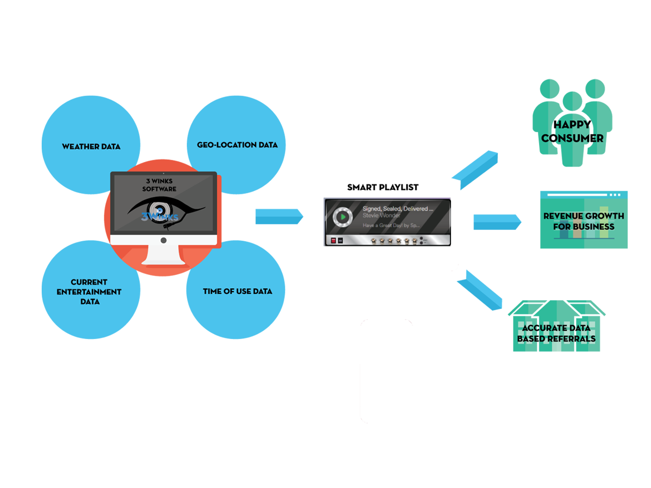
Application Concept Motivation for development
Demo

Slide 3

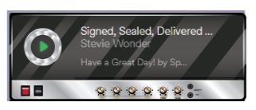
Design Process Technology used and functionality
rainy
sunny
Austin
San Francisco
5:00 AM
Using APIs to pull data for locations, weather, playlists, and entertainment schedules
Selected playlists based on combination of location, weather, and time of day

Slide 4
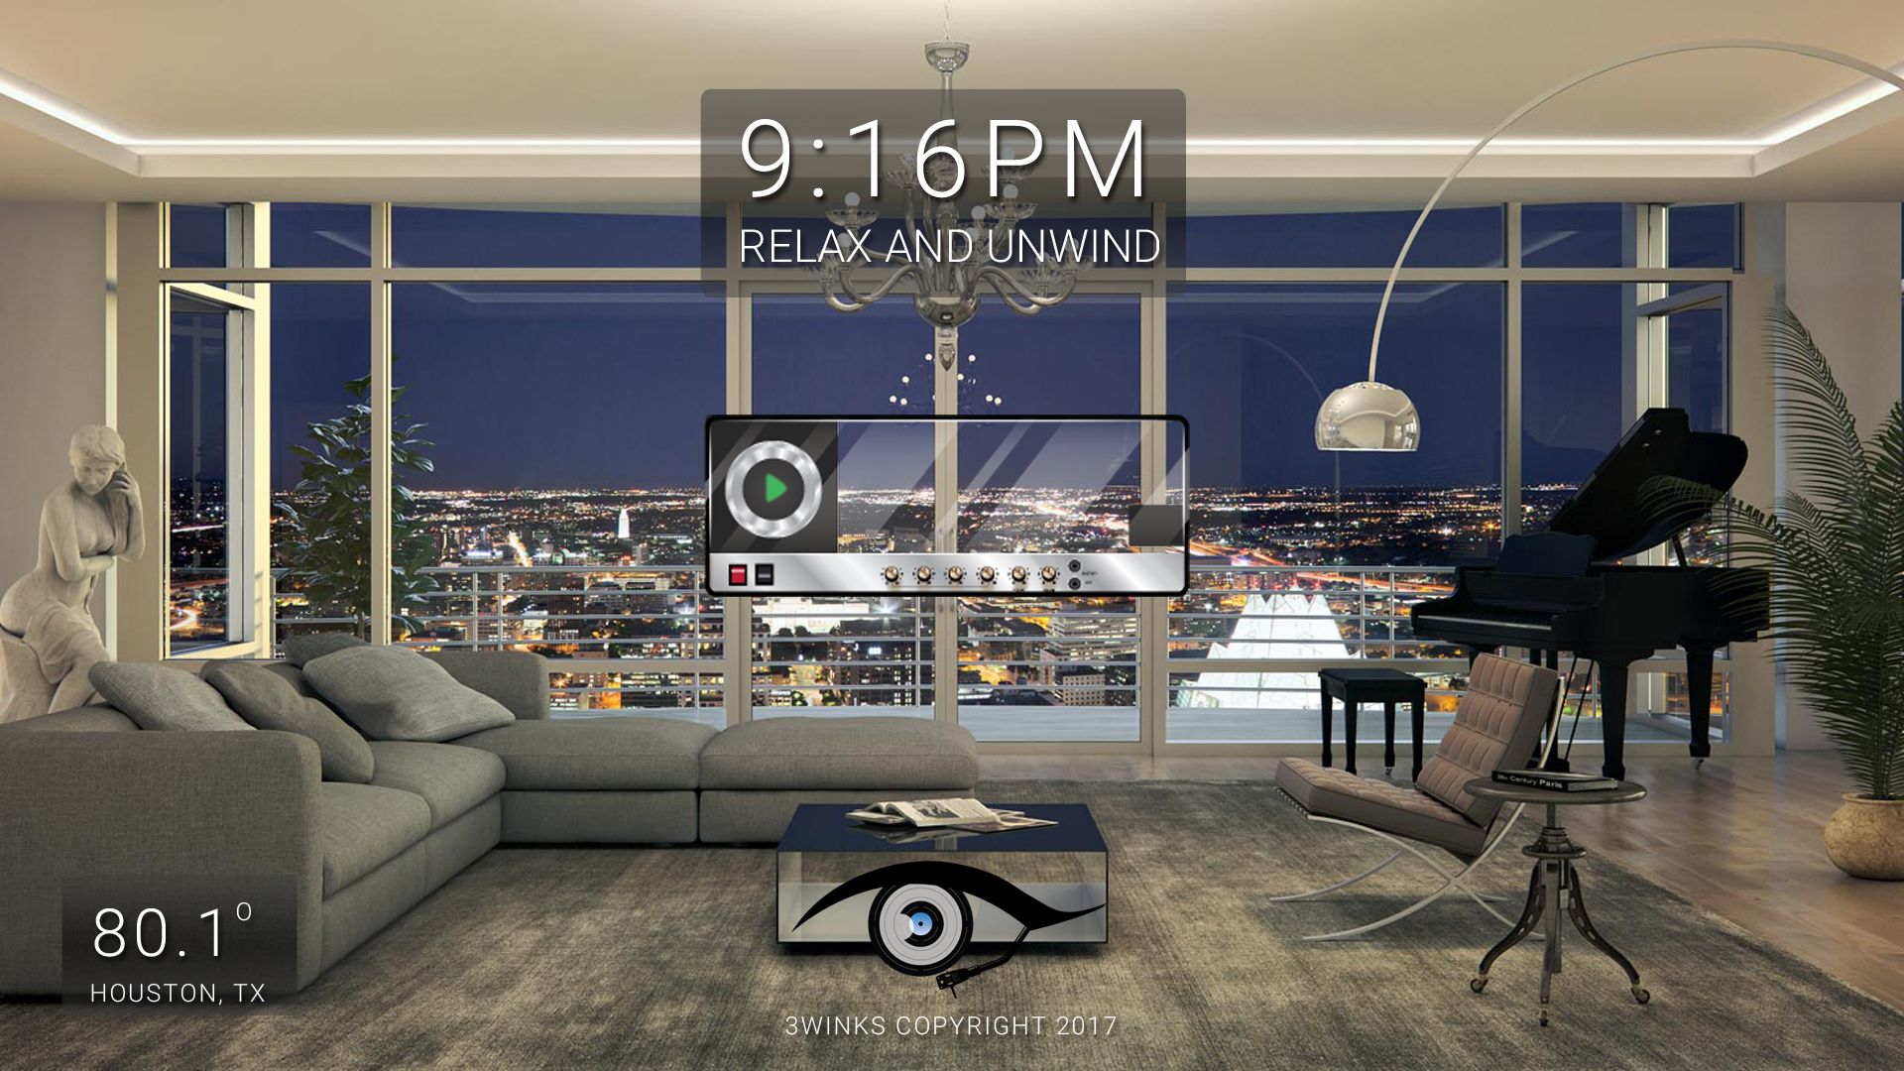
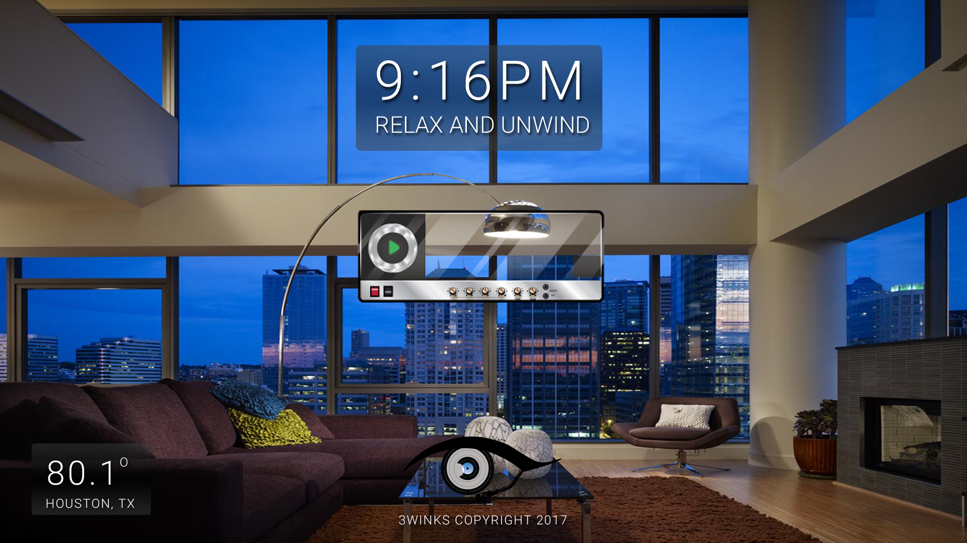
Design Process Technology used and user-interface (UI)
Simple but modern UI design using Foundation
… with enhanced graphic design in Photoshop and Illustrator

Slide 5
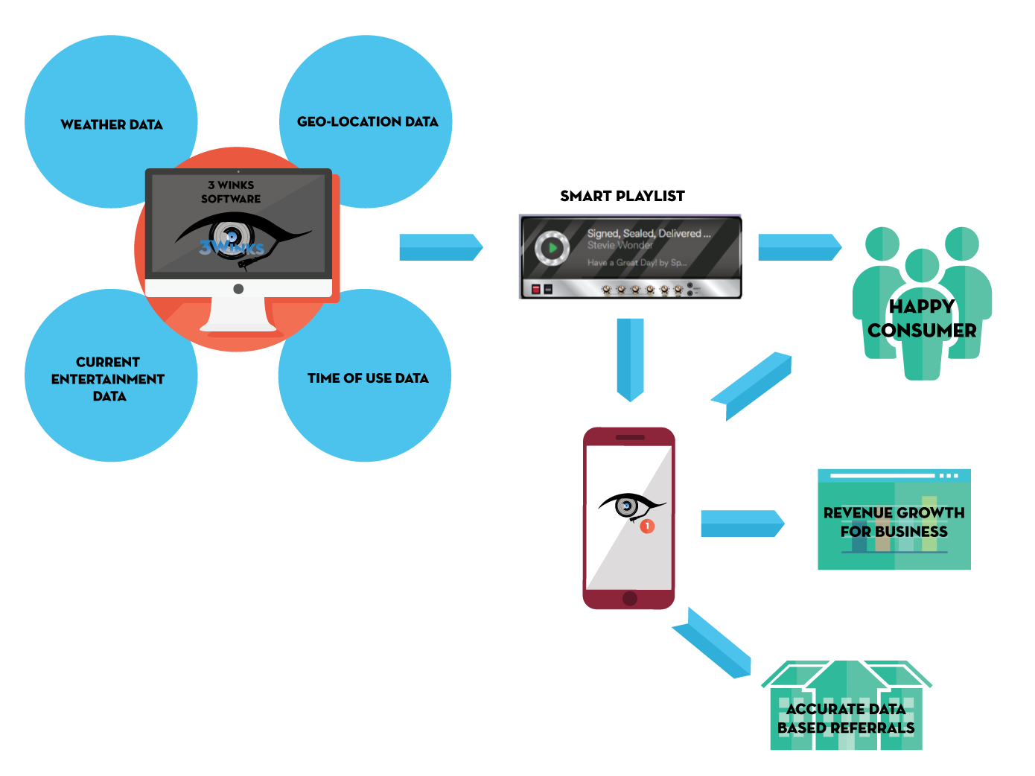
Potential Enhancement Directions for future development

Slide 6

Potential Enhancement Directions for future development
Need a ride?
Italian food
Cup cakes?
Summer
9:00 AM playlist
Coffee shop?
Feeling down?
Full of energy?

Slide 7
The Team behind
Collaboration in functional coding
Collaboration in UI coding
Location and Weather
COREY
Concepts
&
Foundation UI Design
LUIS
Concepts
&
Graphic Design
KEVIN
Concepts
&
Graphic Design
SON
Concepts
&
Presentation
COREY
Google Maps API
KEVIN
Underground Weather API
SON
SeatGeek API
LUIS
Spotify API
Location and Events
Weather and Playlist

